Slide 1
Reading a Weather Map
To find the weather map go to:
http://www.weather.com/maps/maptype/currentweatherusnational/index_large.html

Slide 2
Daily Objective
Read “Why are you Frontin’?”.
Understand weather symbols to read and interpret a map.
Predict future weather patterns.

Slide 3
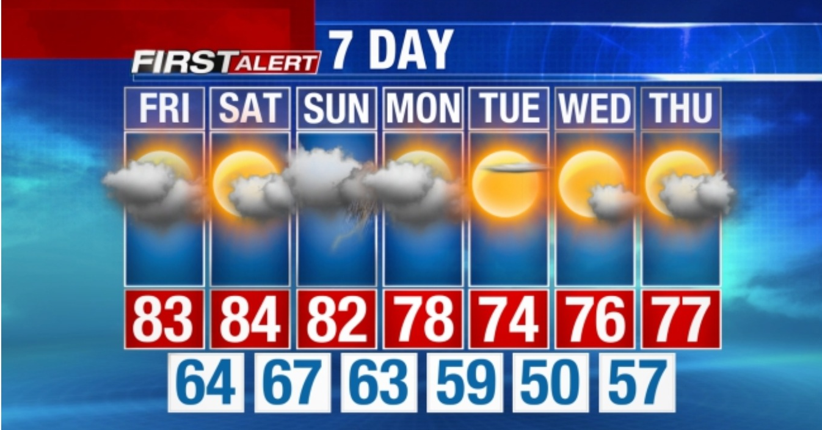
Weather vs Climate
Weather – Current or daily conditions in the atmosphere
Climate – Average of daily weather over long periods of time (years)
Texas Weather – What it is doing today
Texas Climate – Warm & Sunny

Slide 4
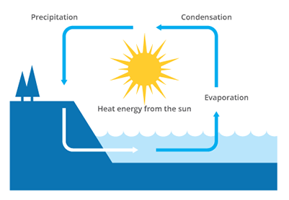
Factors that Influence Weather
The big factors that influence weather and climate worldwide are the Sun, the water cycle, and the atmosphere. Perhaps the largest influence on our planet’s weather and climate is the Sun because the amount of sunlight a location receives will determine its climate.

Slide 5
Cold Front
Symbol
Information
Cold, dry air replaces warm air.
Following a cold front, temperatures drop dramatically.
Precipitation can occur along the front line. Including thunderstorms.

Slide 6
Warm Front
Symbol
Information
Warm moist air replaces cool dry air.
Following a warm front, temperatures increase.
Light precipitation can occur along the front line.

Slide 7
Stationary Front
Symbol
Information
A stationary front occurs when a warm or cold front stops moving.
Noticeable temperature and wind shifts occur when traveling across the front line.
Once the stationary front starts moving again, it becomes warm or cold.

Slide 8
Occluded Front
Symbol
Information
Occurs when a cold front catches up to a warm front. A cold front travels faster than a warm front.
Changes in temperature, humidity, and winds occur with passage of an occluded front. (See diagram to the left.)

Slide 9
High Pressure
Symbol
Information
H
High pressure is usually associated with little or no cloud coverage.
“Happy” weather
Does not mean high temperature

Slide 10
Low Pressure
Symbol
Information
L
Low pressure is usually associated with cloudy weather, storms, precipitation, etc
“Lousy” weather

Slide 11
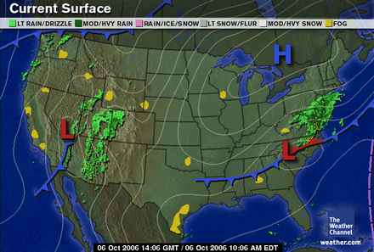

Slide 12
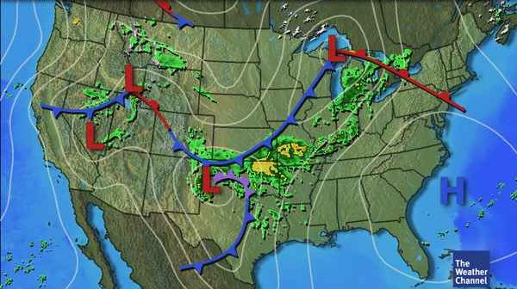

Slide 13
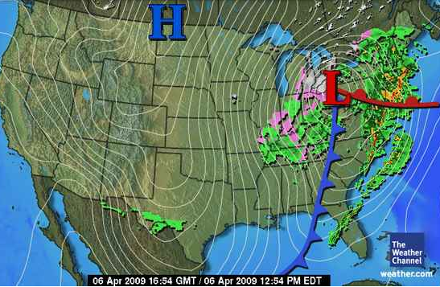

Slide 16
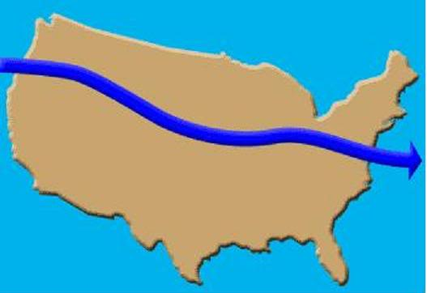
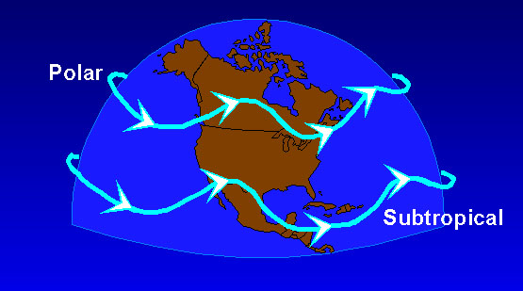
Due to the jet stream, a high altitude current of fast moving air, weather generally moves toward the east in North America.
In North America, weather systems generally move toward the east.
If it is raining in Texas today, it will be raining in Louisiana tomorrow.
https://www.youtube.com/watch?v=OPhC63uznMc
https://www.youtube.com/watch?v=m2Gy8V0Dv78
https://www.youtube.com/watch?v=fX7Q-0QuID4

