Slide 2
WELCOME
Welcome to McKinney North High School and the 14th season of Bulldog Wrestling. I hope you and your wrestler are as excited as I am and hope your enthusiasm grows throughout this season and for many years to come.
Shawn Brasher Head Wrestling Coach
https://staff.mckinneyisd.net/MNHS/sbrasher/_layouts/15/start.aspx#/

Slide 3
Join Remind
Group Texting
To: 81010
@a6fd8he
(Booster Club)

Slide 4
AGENDA
INTRODUCTION OF ADMINISTRATION & STAFF
INFORMATION ABOUT UPCOMING SEASON
COMMUNICATION
FORMS
CONTACT INFORMATION
QUESTIONS
BOOSTER CLUB

Slide 5
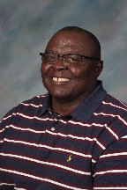
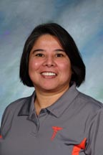
INTRODUCTION OF
ADMINISTRATION & STAFF
HEAD COACH: SHAWN BRASHER
ASSISTANT COACH: CHARLES BENSON
---------------------------------------------------------------
SUPERINTENDENT: Dr. RICK McDANIEL
PRINCIPAL: JIMMY SPANN
ATHLETIC DIRECTOR: SHAWN PRATT
CAMPUS DIRECTOR: MIKE FECCI
ASSISTANT TO CD: CYNTHIA BEASLEY
ATHLETIC TRAINERS: MIKE DEAL
ELICIA LEAL

Slide 6
TRAINING ROOM PROCEDURES
Mike Deal
Elicia Leal

Slide 7
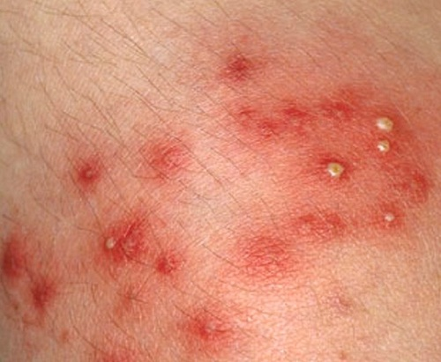
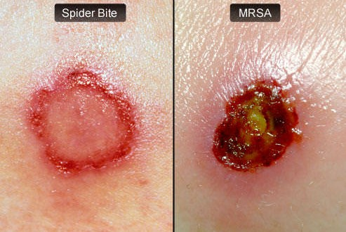
SKIN INFECTIONS
RINGWORM STAPH
MRSA
Methicillin-resistant Staphylococcus aureus

Slide 8
INFORMATION ABOUT
UPCOMING SEASON
TRAINING ROOM PROCEDURES
PRACTICE
EQUIPMENT
DISCIPLINE
WEIGHT CLASSES & CERTIFICATION
WEIGH-IN
TRANSPORTATION
MEET PROCEDURES
SCHEDULE
CALENDAR
LETTERING POLICY
ELIGIBILITY

Slide 9
PRACTICE
PRACTICE WILL BEGIN ON MONDAY, OCTOBER 17th
PRACTICE WILL BEGIN AT 3:00 AND END BY 5:30/6:00 PM
ALL WRESTLERS ARE EXPECTED TO BE AT PRACTICE, DRESSED OUT, & ON TIME (HURT or INJURED)
COACH BRASHER IS THE ONLY PERSON WHO IS ALLOWED TO EXCUSE A PLAYER FROM PRACTICE
IF PRACTICE IS TO BE MISSED, I EXPECT TO BE NOTIFIED IN PERSON IF POSSIBLE OR AT THE VERY LEAST A PHONE CALL, E-MAIL, OR WRITTEN NOTE FROM PARENTS OR DOCTOR IS EXPECTED
MESSAGES FROM OTHER WRESTLERS (VERBAL OR WRITTEN) WILL NOT BE ACCEPTED
NO JEWELRY OR TORN CLOTHING
WRESTLERS WILL NEED TO SHOWER AFTER EVERY PRACTICE (WITH SOAP) AND DRY OFF

Slide 10
PRACTICE
GRADES:
MINUS 2,4,6,8,10 pts FOR EVERY EXCUSED ABSENCE
MINUS 10 pts FOR EVERY UNEXCUSED ABSENCE
YOU MUST CALL AS SOON AS YOU ARE ABSENT
MINUS 3,6,10 pts FOR EVERY TARDY
TUTORIALS FROM 2:30 TO 3:00
PRACTICE STARTS AT 3:15

Slide 11
EQUIPMENT
WRESTLERS WILL NEED TO BE DRESSED OUT IN TEAM PRACTICE SHIRT AND PRACTICE SHORTS (TEAM UNIFORM FOR TOURNAMENTS)
PLEASE SEE ORDER FORM FOR GEAR 4 Shirts 4x$12.50=$50 4 Shorts 4x$20.00=$80 1 Warm Up Top 1x$35.00=$35 1 Laundry Bag 1x$10.00=$10 Total $175
SHIRT & SHORTS MUST BE CHANGED EVERDAY
SHIRTS WILL BE TUCKED IN AT ALL TIMES
PLAYERS WILL WEAR SHIRT/SHORTS IN HALLWAYS
SHIRTS & SHORTS ARE NOT TO BE CUT

Slide 12
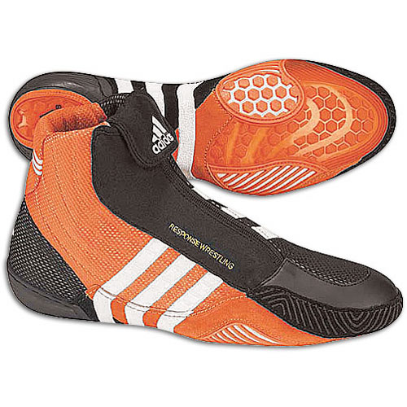
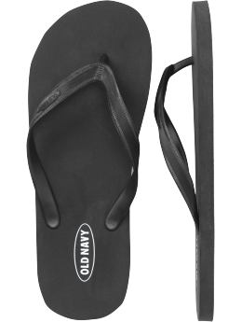
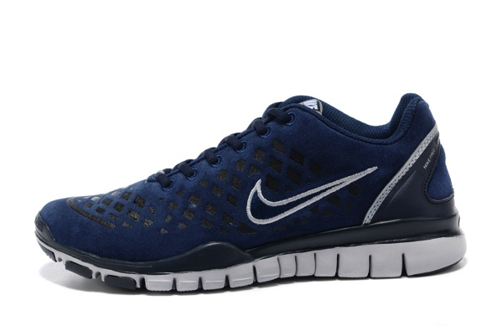
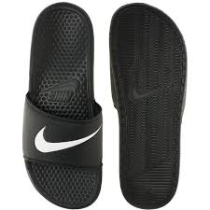
EQUIPMENT
WRESTLERS WILL PROVIDE THEIR OWN SHOES (MUST HAVE LACE COVERS)
LAST YEARS MODELS-HALF OFF
www.wwsport.com
www.wrestlingaids.com
WRESTLERS WILL ALSO NEED RUNNING SHOES, SOCKS, SWEATS, TOWEL, SHOWER SANDALS

Slide 13
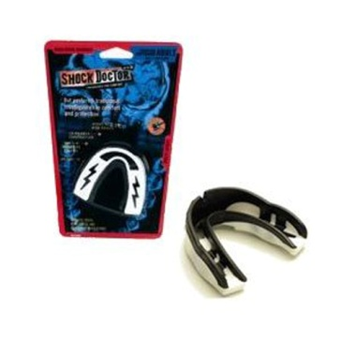
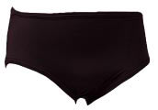
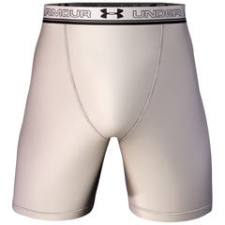
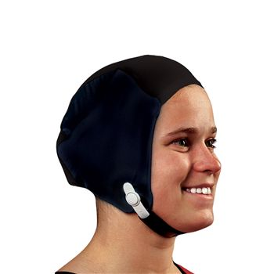
EQUIPMENT
WRESTLERS MUST INVEST IN WRESTLING BRIEF ($12-20)
MOUTHPIECE (BRACES)
HEADCOVER
KNEE PADS!!!

Slide 14
DISCIPLINE
Players will meet before practice to make up the following discipline infractions or any other deemed necessary: (30 min)
Excused absence – 15 suicides, 100 push ups, 100 sit ups
Unexcused absence – 30 suicides, 250 push ups, 250 sit ups
Conduct in classroom - 30 suicides, 250 push ups, 250 sit ups
Failing grades (75)- 15 suicides, 100 push ups, 100 sit ups (Tutoring)
Tardy to A.P. or practice - 15 suicides, 100 push ups, 100 sit ups
Unacceptable language - 15 suicides, 100 push ups, 100 sit ups
Unacceptable behavior- 30 suicides, 250 push ups, 250 sit ups
Untidy locker room - 15 suicides, 100 push ups, 100 sit ups (Team)
Untidy individual locker - 15 suicides, 100 push ups, 100 sit ups
Loss of equipment – 15 suicides, 100 push ups, 100 sit ups (must pay)
Poor attitude or effort - 15 suicides, 100 push ups, 100 sit ups

Slide 15
WEIGHT CLASSES
High school wrestlers compete in the following NEW weight classes:
106, 113, 120, 126, 132, 138, 145, 152, 160, 170, 182, 195, 220, 285
OLD weight classes:
103, 112, 119, 125, 130, 135, 140, 145, 152, 160, 171, 180, 189, 215, 285

Slide 16
WEIGHT CERTIFICATION
Tuesday, November 1st at McKinney High
URINE SPECIFIC GRAVITY ASSESSMENT (Magical # is a density below 1.025) (refractometer)
(pass or fail)
Every wrestler must establish their alpha weight (example 124 lbs)
Body Fat Percent via Skin Fold Measurements Triceps, Subscapular, Abdominal (7% Minimum)
(example 12% body fat)

Slide 17
WEIGHT CERTIFICATION
FAT FREE BODY WEIGHT
(how much you would weigh without any fat)
Example 100-12 = 88
124 x 0.88 = 109.12 pounds
MINIMUM WEIGHT
(example 109.12 / 0.93 = 117.33 pounds) (119)
THE DESCENT The wrestler can only lose a maximum of 1.5 % of the alpha weight per week.
(example 124 x 0.015 = 1.86 ponds)

Slide 18
WEIGHT CERTIFICATION
THE DESCENT The wrestler can only lose a maximum of 1.5 % of the alpha weight per week.
(example 124 x 0.015 = 1.86 ponds)
(124 – 119 = 5 pounds)
(Week 1: 124 – 1.86 = 122.14)
(Week 2: 122.14 – 1.86 = 120.28)
(Week 3: 120.28 – 1.86 = 118.42)
So this wrestler will not be able to wrestle at his minimum weight until 3 weeks after certification!

Slide 19
WEIGHT CERTIFICATION
A two-pound growth allowance may be added to each weight class any time after the date of certification.)
Without being recertified at a higher weight, a wrestler cannot weigh in more than one weight class above his certified weight.

Slide 20
WEIGH-IN
Wrestlers weigh in 30-60 minutes before a dual meet is scheduled to begin
Wrestlers weigh in 1-2 hours before a tournament is scheduled to begin
When there are consecutive days of team competition, all wrestlers are granted an additional one pound allowance each day.
Contestants cannot wrestle more than one weight class above their weigh-in weight.

Slide 21
TRANSPORTATION
TRANSPORTATION WILL BE BY BUS FOR MOST MEETS (SUV FOR REGION & STATE)
DEPARTURE TO & RETURN FROM MEETS WILL BE AT MNHS MULTIPURPOSE BUILDING
ALL WRESTLERS ARE EXPECTED TO RIDE WITH THE TEAM TO AND FROM EACH MEET
ONLY IN CASES OF EMERGENCY OR PRIOR APPROVAL (ONE WEEK) WILL A STUDENT BE ALLOWED TO LEAVE A MEET (W/ PARENT)
ANY WRESTLER LEAVING WITH PARENT MUST SIGN A TRAVEL RELEASE FORM

Slide 22
MEET PROCEDURES
ARRIVE AS A TEAM & WEIGH IN
BREAK (1-2 HOURS)
EAT
WARM-UP
DUALS (2 HOURS)
TOURNAMENT (ALL DAY)
DEPART AS A TEAM

Slide 23
MEET PROCEDURES
I am always open to listening to your concerns
Parents will not be allowed on the floor, wrestling area, or coaches corners.
Nobody is allowed on the wrestling floor except wrestlers & wrestling staff
During a meet or in the middle of practice is not a good time to have a discussion
Feel free to call, e-mail, or make an appointment to stop by and talk
If you or your wrestler has a concern, it is my concern as well.

Slide 24
SCHEDULE
SEE
INFORMATION
PACKET

Slide 25
CALENDAR
PRACTICE
HOLIDAYS (practice)
DUALS & TOURNAMENTS
END OF SEASON (for everyone)

Slide 26
LETTERING POLICY
LETTERING CAN BE ACCOMPLISHED BY:
Earn 25 points in varsity competitions
remaining academically eligible the entire season
having no unexcused absences
Maintaining the character of a MNHS wrestler
All wrestlers that start and finish the season successfully will receive a certificate signifying their hard work and accomplishments.

Slide 27
COMMUNICATION
www.rankonesport.com
www.mckinneyisd.net
http://legacy.mckinneyisd.net/Campuses/school_websites/mnhs/
https://staff.mckinneyisd.net/MNHS/sbrasher/_layouts/15/start.aspx#/
SCHEDULE
DIRECTIONS
MAPS
RESULTS
SUMMARY
ROSTERS
PICS
E-MAIL

Slide 28
FORMS
PHYSICAL ON FILE
EMERGENCY CARDS
COPY OF BIRTH CERTIFICATE
PROOF OF RESIDENCY
EXTRACURRICULAR CONTRACT FORMS
ACKNOWLEDGEMENT OF RULES
DRUG/ALCOHOL SCREENING CONSENT FORM
STEROID FORM
PERSONAL INFORMATION RELEASE FORM
ACADEMIC RELEASE FORM
WEB PAGE RELEASE FORM
PREVIOUS ATHLETIC PARTICIPATION FORMS
All required annual forms can now be filled out electronically online: http://mckinneyisd.rankonesport.com

Slide 29
CONTACT INFORMATION
SHAWN BRASHER
HEAD WRESTLING COACH
McKINNEY NORTH HIGH SCHOOL
2550 WILMETH ROAD
McKINNEY , TX 75071
PHONE: 469-302-4300 x4569
CELL: 214-212-4682
E-MAIL: sbrasher@mckinneyisd.net
WEB: https://staff.mckinneyisd.net/MNHS/sbrasher/_layouts/15/start.aspx#/SitePages/Home.aspx
CONFERENCE: 11:45-12:40 or by appointment

Slide 30
QUESTIONS?

Slide 31
BOOSTER CLUB
PRESIDENT- LaShawn Johnson
VICE-PRESIDENT- Orlanthea Mosley
TREASURER- LeeAnn Garza
SECRETARY- Deena Still
We need HELP!

