Slide 1
PART THREE AN AGE OF ACCELERATING CONNECTIONS 500-1500 Chapter 7—Commerce and Culture, 500-1500 Chapter 8—China and the World: East Asian Connections, 500-1300 Chapter 9—The Worlds of Islam: Afro-Eurasian Connections, 600-1500 Chapter 10—Th Worlds of Christendom: Contraction, Expansion, and Division, 500-1300 Chapter 11—Pastoral Peoples on the Global Stage: The Mongol Moment, 1200-1500 Chapter 12—The Worlds of the Fifteenth Century
Robert W. Strayer
Copyright © 2009 by Bedford/St. Martin’s
Notes:
*

Slide 2
OUTLINE: THE BIG PICTURE: DEFINING A MILLENNIUM
I. It is difficult to see when one phase of human history ends and another begins.
A. Between about 200 and 850 C.E., many second-wave states and civilizations were disrupted, declined, or collapsed.
B. Columbus's transatlantic voyages around 1500 mark a new departure in world history for most people.
C. How should we understand the millennium that stretches from the end of the second-wave era to the beginning of modern world history?
1. difficult to define a distinct identity for this period
a. some call it "postclassical," others "medieval" or "middle"
b. this textbook uses the phrase "third- wave civilizations"

Slide 3
OUTLINE: THE BIG PICTURE: DEFINING A MILLENNIUM
II. Third-Wave Civilizations: Something New, Something Old, Something Blended
Various regions followed different trajectories in this era.
Several distinct patterns of development emerged:
1. some areas saw creation of new but smaller civilizations where none had existed before
a. East African Swahili civilization
b. Ghana, Mali, and Songhay in West Africa
c. Kievan Rus
d. new civilizations in East and Southeast Asia
2. all were part of the pattern of increasing globalization of civilization
a. the new civilizations were distinctive, but similar to earlier civilizations
b. all borrowed heavily from earlier or more established centers
3. the most expansive and influential third-wave civilization was Islam
4. some older civilizations persisted or were reconstructed (e.g., Byzantium, China, India)
a. collapse of Maya civilization and Teotihuacan opened the way to a reshaping of an ancient civilization
b. the Inca formed an empire out of various centers of Andean civilization
5. Western Europe: successor states tried to maintain links to older Greco-Roman- Christian traditions
a. but far more decentralized societies emerged, led by Germans
b. hybrid civilization was created of Greco-Roman and Germanic elements
c. development of highly competitive states after 1000 c.E.

Slide 4
OUTLINE: THE BIG PICTURE: DEFINING A MILLENNIUM
III. The Ties That Bind: Transregional Interaction in the Third-Wave Era
A. An important common theme is the great increase in interaction between the world's regions, cultures, and peoples.
1. increasingly, change was caused by contact with strangers and/or their ideas, armies, goods, or diseases
2. cosmopolitan regions emerged in a variety of places—"mini-globalizations"

Slide 5
OUTLINE: THE BIG PICTURE: DEFINING A MILLENNIUM
III. The Ties That Bind: Transregional Interaction in the Third-Wave Era
B. Part Three highlights the accelerating pace of interaction in the third-wave era, giving special attention to three major mechanisms of interaction:
1. trade, especially the growth of long­ distance commerce
a. trade led to the establishment of many new states or empires
b. religious ideas, technologies, and germs also moved along trade routes
2. large empires, incorporating many distinct cultures under a single political system
a. provided security for long-distance trade
b. many of the third-wave civilizations were larger than earlier ones (Arab, Mongol, and Inca empires)
c. the largest empires were created by nomadic or pastoral peoples (Arabs, Berbers, Turks, Mongols, Aztecs), who ruled over agriculturalists
3. large-scale empires and long-distance trade worked together to facilitate the spread of ideas, technologies, crops, and germs
a. wide diffusion of religions
b. wide diffusion of technologies, many from China and India
c. devastating epidemic disease (e.g., Black Death) linked distant communities

Slide 6
OUTLINE: THE BIG PICTURE: DEFINING A MILLENNIUM
III. The Ties That Bind: Transregional Interaction in the Third-Wave Era
C. A focus on accelerating connections puts a spotlight on travelers rather than on those who stayed at home.
D. A focus on interaction raises questions for world historians about how much choice individuals or societies had in accepting new ideas or practices and about how they made those decisions.
E. Visible "action" of third-wave civilizations featured male actors.
useful to remember women remain central to family life
repositories of language, religious ritual, group knowledge, local history
female labor generated many long­distance trade products
realms not completely separate and changing roles and relationships between men and women also play role in period

Slide 7
Ways of the World: A Brief Global History First Edition
Robert W. Strayer
CHAPTER 8
Commerce and Culture
500–1500
Copyright © 2009 by Bedford/St. Martin’s
Notes:
*

Slide 8
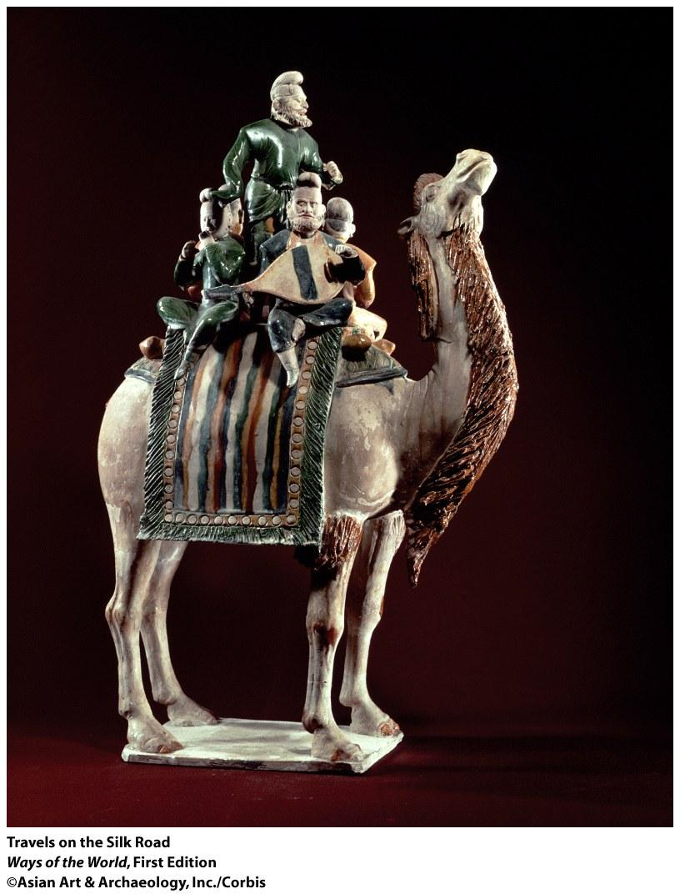
Travels on the Silk Road: This Chinese ceramic figurine from the Tang dynasty (618–907 C.E.) shows a group of musicians riding on a camel along the famous Silk Road commercial network that long linked the civilizations of western and eastern Eurasia. The bearded figures represent Central Asian merchants, while the others depict Chinese. (©Asian Art & Archaeology, Inc./Corbis)

Slide 9
I. Opening Vignette
A. An Apple iPod ordered in the United States can be shipped from China in 40 hours.
speed of transaction a very recent development
but also evoke older patterns of global commerce
B. The roots of economic globalization lie deep in the past.
exchange of goods between people of different ecological zones is a major feature of human history
at times, some societies have monopolized desirable products (like silk)
long-distance trade became more important than ever in 500-1500 C.E.
a. most trade was indirect
b. creation of a network of communication and exchange across the Afro-Eurasian world; a separate web in parts of the Americas

Slide 10
I. Opening Vignette
C. Why was trade significant?
altered consumption
encouraged specialization
diminished economic self-sufficiency of local societies
traders often became a distinct social group
sometimes was a means of social mobility
provided prestige goods for elites
sometimes the wealth from trade motivated state creation
religious ideas, technological innovations, plants and animals, and disease also spread along trade routes
D. The network of long-distance commerce is a notable feature of the third-wave civilizations.

Slide 11
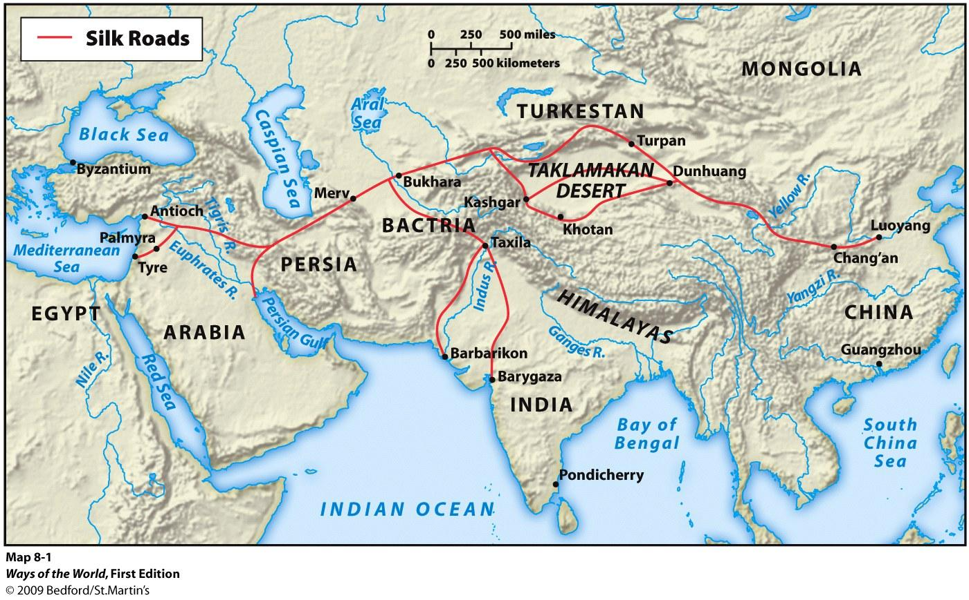
II. Silk Roads: Exchange across Eurasia
Notes:
*

Slide 12
II. Silk Roads: Exchange across Eurasia
A. Silk Roads form one of world's most extensive and sustained networks of exchange.
largely a relay trade
provided a unity and coherence to Eurasian history
Notes:
*

Slide 13
II. Silk Roads: Exchange across Eurasia
B. The Growth of the Silk Roads
1. Eurasia is often divided into inner and outer zones with different ecologies
a. outer Eurasia: relatively warm, well- watered (China, India, Middle East, Mediterranean)
b. inner Eurasia: harsher, drier climate, much of it pastoral (eastern Russia, Central Asia)
c. steppe products were exchanged for agricultural products and manufactured goods
2. creation of second-wave civilizations and imperial states in the last five centuries B.C.E. included efforts to control pastoral peoples
trading networks did best when large states provided security for trade
a. when Roman and Chinese empires anchored commerce
b. in seventh and eighth centuries, the Byzantine Empire, Abbasid dynasty, and Tang dynasty created a belt of strong states
c. in thirteenth and fourteenth centuries, Mongol Empire controlled almost the entirety of the Silk Roads
Notes:
*

Slide 14
II. Silk Roads: Exchange across Eurasia
C. Goods in Transit
1. a vast array of goods traveled along the Silk Roads, often by camel
a. mostly luxury goods for the elite
b. high cost of transport did not allow movement of staple goods
2. silk symbolized the Eurasian exchange system
a. at first, China had a monopoly on silk technology
b. by the sixth century C.E., other peoples produced silk
c. silk was used as currency in Central Asia
d. silk was a symbol of high status
e. silk industry only developed in Western Europe in twelfth century
3. volume of trade was small, but of economic and social importance
a. peasants in the Yangzi River delta of southern China produced market goods (silk, paper, porcelain, etc.) instead of crops
b. well-placed individuals could make enormous profits
Notes:
*

Slide 16
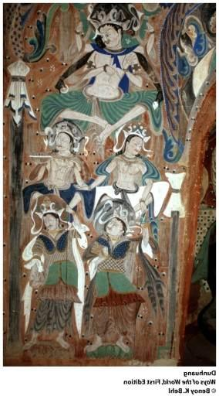
II. Silk Roads: Exchange across Eurasia
D. Cultures in Transit
cultural transmission was more important than exchange of goods
the case of Buddhism
a. spread along Silk Roads through Central and East Asia
b. had always appealed to merchants
c. conversion was heavy in the oasis cities of Central Asia
d. conversion was voluntary
e. many of the Central Asian cities became centers of learning and commerce e.g., Buddhist texts and cave temples of Dunhuang
f. spread much more slowly among Central Asian pastoralists
g. in China, was the religion of foreign merchants or rulers for centuries
h. Buddhism was transformed during its spread
Notes:
*

Slide 17
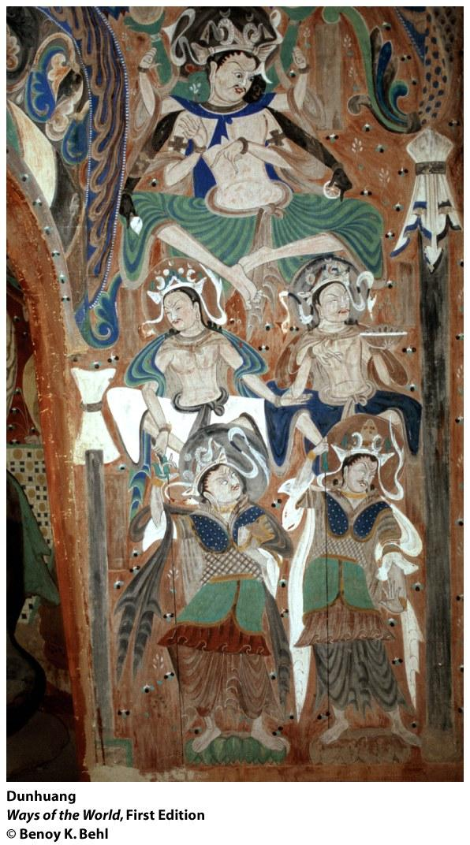
Dunhuang Located in western China at a critical junction of the Silk Road trading network, Dunhuang was also a center of Buddhist learning, painting, and sculpture as that religion made its way from India to China and beyond. In some 492 caves, a remarkable gallery of Buddhist art has been preserved. These images of Buddhist deities and heavenly beings date from the sixth century C.E.

Slide 18
II. Silk Roads: Exchange across Eurasia
E. Disease in Transit
the major population centers of the Afro-Eurasian world developed characteristic disease patterns and ways to deal with them
long-distance trade meant exposure to unfamiliar diseases
a. early case: great epidemic in Athens in 430-29 B.C.E.
during the Roman and Han empires, smallpox and measles devastated both populations
in 534-750 C.E., bubonic plague from India ravaged Mediterranean world
3. the Black Death spread thanks to the Mongol Empire's unification of much of Eurasia (thirteenth-fourteenth centuries)
a. could have been bubonic plague, anthrax, or collection of epidemic- diseases
b. killed as much as one-half of European population between 1346 and 1350
c. similar death toll in China and parts of the Islamic world
d. Central Asian steppes were badly affected (undermined Mongol power)
4. disease exchange gave Europeans an advantage when they reached the Western Hemisphere after 1500
Notes:
*

Slide 19
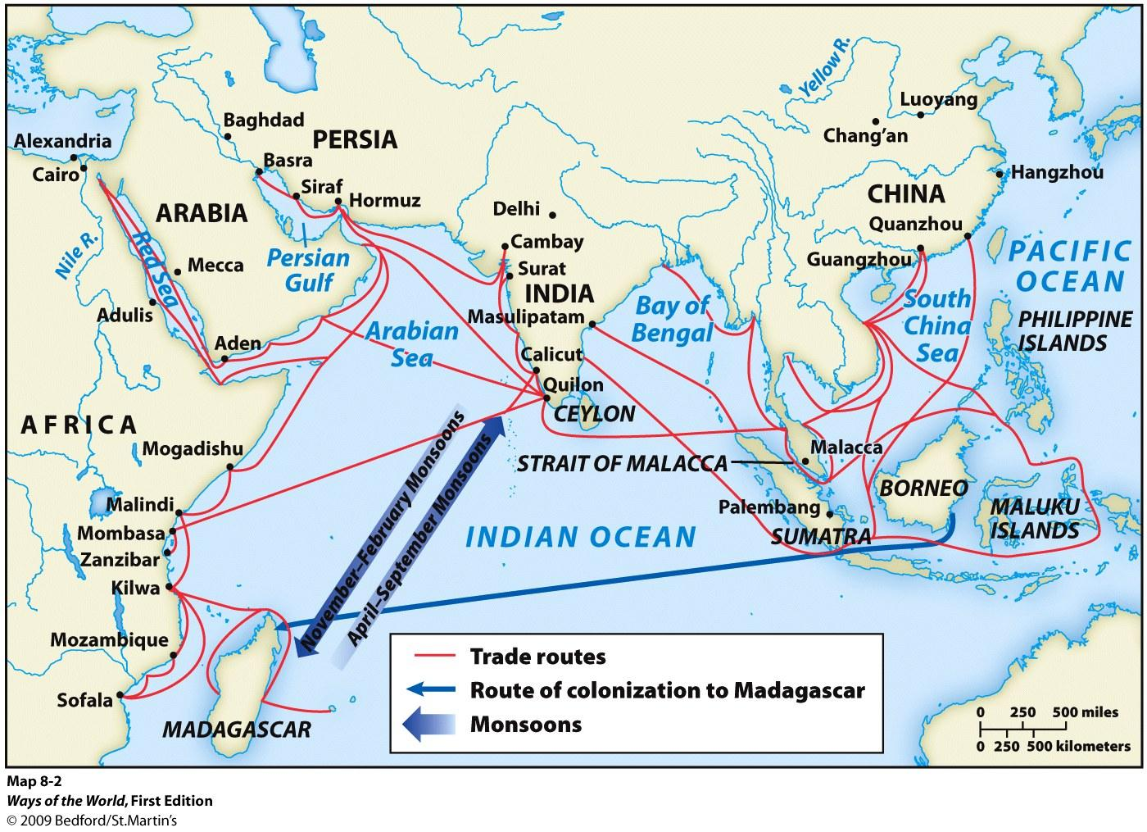
III. Sea Roads: Exchange across the Indian Ocean
Notes:
*

Slide 20
III. Sea Roads: Exchange across the Indian Ocean
The Mediterranean Sea was an avenue for commerce from the time of the Phoenicians.
Venice was a center of commerce by 1000 C.E.
controlled trade of imports from Asia
linked Europe to the much greater trade network of the Indian Ocean
Notes:
*

Slide 21
III. Sea Roads: Exchange across the Indian Ocean
B. The Indian Ocean network was the world's most important until after 1500.
trade grew from environmental and cultural diversity
transportation was cheaper by sea than by land
made transportation of bulk goods possible (textiles, pepper, timber, rice, sugar, wheat)
commerce was possible thanks to monsoons (alternating wind currents)
commerce was between towns, not states
Notes:
*

Slide 22
III. Sea Roads: Exchange across the Indian Ocean
C. Weaving the Web of an Indian Ocean World
1. Indian Ocean trade started in the age of the First Civilizations
a. Indus Valley writing may have been stimulated by cuneiform
b. ancient Egyptians and Phoenicians traded down the Red Sea
c. Malay sailors reached Madagascar in the first millennium B.C.E.
2. tempo of commerce increased in early centuries C.E. with greater understanding of monsoons
a. merchants from Roman Empire settled in southern India and East African coast
b. growing trade in eastern Indian Ocean and South China Sea
3. fulcrum of trade was India
4. two great encouragers for the Indian Ocean exchange:
a. economic and political revival of China
b. rise of Islam in seventh century C.E.
Notes:
*

Slide 23
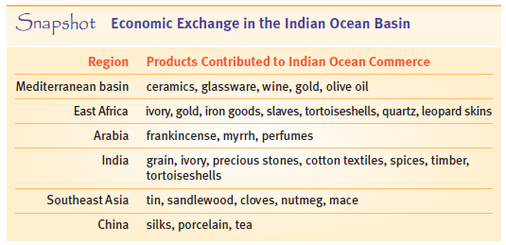

Slide 24
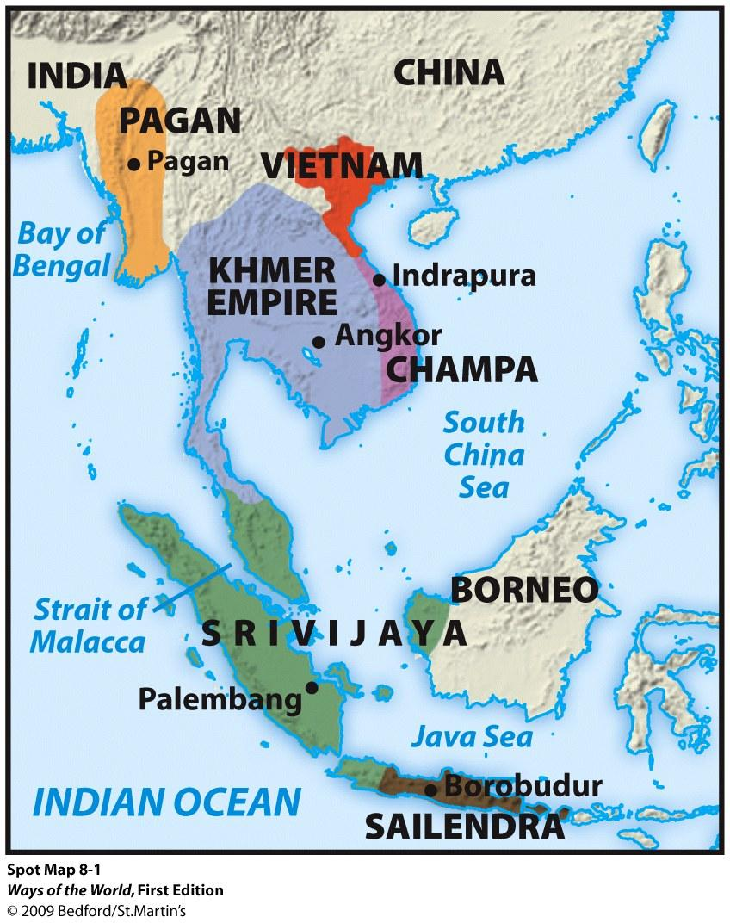
Southeast Asia

Slide 25
III. Sea Roads: Exchange across the Indian Ocean
D. Sea Roads as a Catalyst for Change: Southeast Asia
1. ocean commerce transformed Southeast Asia and East Africa
a. trade stimulated political change
b. introduction of foreign religious ideas
2. Southeast Asia: location between China and India made it important
a. Malay sailors opened an all-sea route between India and China through the Straits of Malacca ca. 350 C.E.
b. led many small ports to compete to attract traders
3. Malay kingdom of Srivijaya emerged from competition, dominated trade from 670 to 1025 C.E.
a. gold, access to spices, and taxes on ships provided resources to create a state
Notes:
*

Slide 26
III. Sea Roads: Exchange across the Indian Ocean
D. Sea Roads as a Catalyst for Change: Southeast Asia
4. Inland states based on rice production also participated
a. Funan (0-600 C.E.) in modern Vietnam and eastern Cambodia hosted merchants from India and China
b.Khmer kingdom of Angkor (800-1300 C.E.) exported exotic forest products and attracted Chinese merchants
c. Champa in modern Vietnam tried to control trade between China and Southeast Asia provoking warfare
Notes:
*

Slide 27
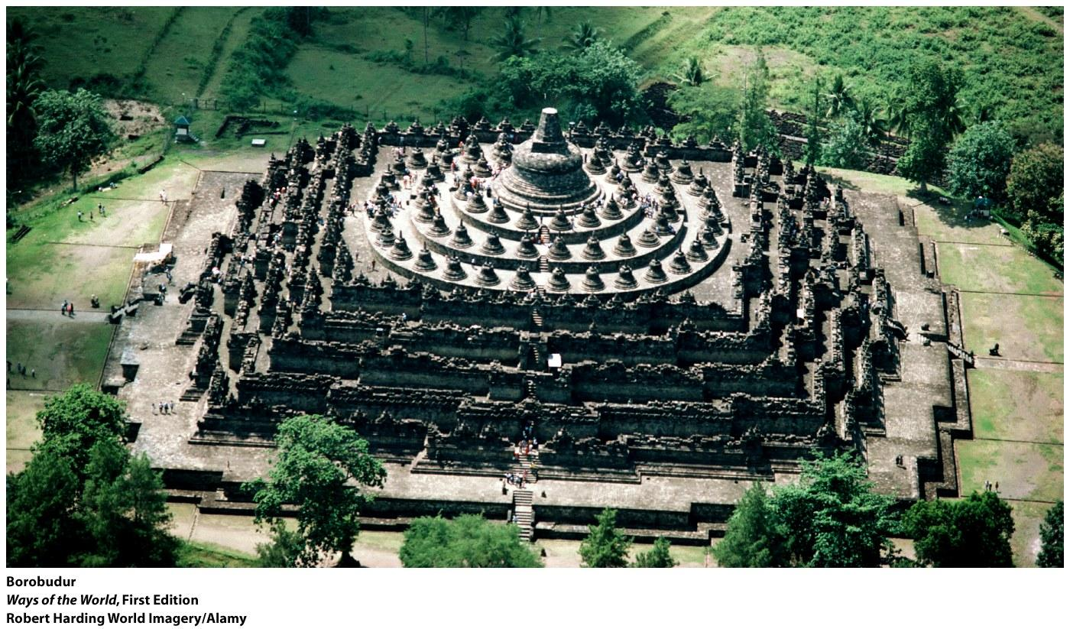
Borobudur- Khmer state of Angkor

Slide 28
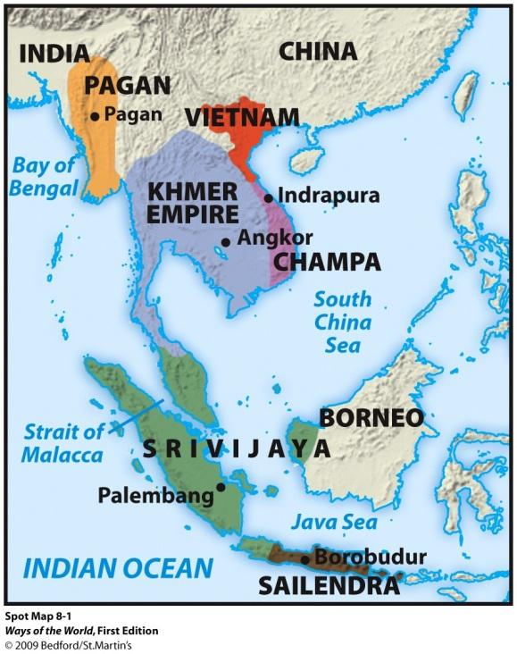
III. Sea Roads: Exchange across the Indian Ocean
D. Sea Roads as a Catalyst for Change: Southeast Asia
5. Elements of Indian culture spread to South East Asia, Chinese culture to Vietnam
a. Indian alphabets, artistic forms, political and religious ideas and especially Buddhism
6. Sailendras kingdom (central Java) was also influenced by India
a. massive building of Hindu and Buddhist centers (eighth-tenth centuries)
b. shows Buddhist cultural grounding in Javanese custom
Notes:
*

Slide 29
III. Sea Roads: Exchange across the Indian Ocean
D. Sea Roads as a Catalyst for Change: Southeast Asia
7. Hinduism also found a place in Southeast Asia, especially in Champas and Angkor
8. "Indianization" of Southeast Asia a voluntary process
a. traditional practices mixed or existed alongside new Indian ideas and practices
b.little conflict between
c. less patriarchal traditions of Southeast Asia persist
9. Islam penetrated later
Notes:
*

Slide 30
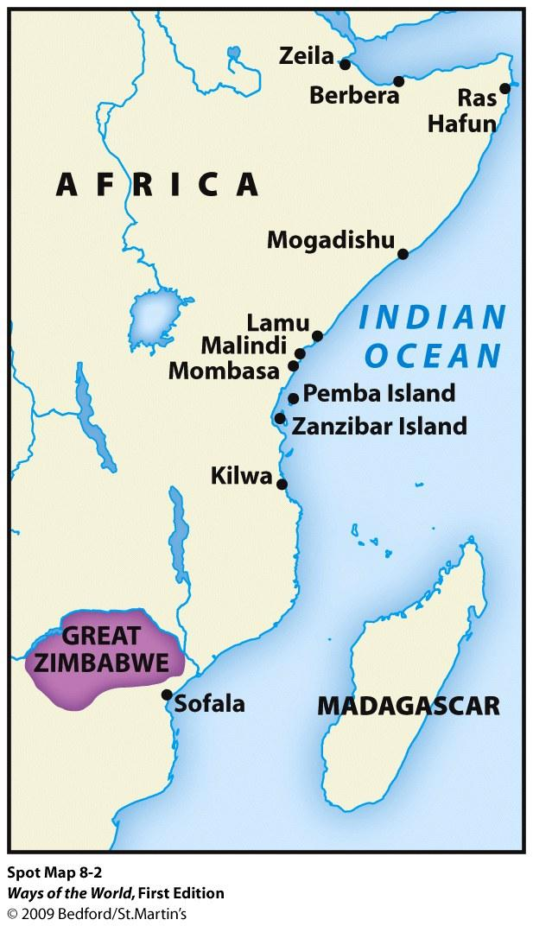
East Africa

Slide 31
III. Sea Roads: Exchange across the Indian Ocean
E. Sea Roads as a Catalyst for Change: East Africa
1. Swahili civilization of East Africa developed from blend of Bantu with commercial life of the Indian Ocean (especially Islamic)
a. growing demand for East African products (gold, ivory, quartz, leopard skins, some slaves, iron, wood products)
b. African merchant class developed, with towns and kingships
2. Swahili civilization flourished on East African coast between 1000 and 1500 C.E.
a. very urban, with cities of 15,000- 18,000 people
b. each city was politically independent, ruled by a king
c. accumulated goods from the interior and traded for Asian goods
d. sharp class distinctions
Notes:
*

Slide 32
III. Sea Roads: Exchange across the Indian Ocean
E. Sea Roads as a Catalyst for Change: East Africa
3. most of trade was in Arab ships; Swahili craft traveled coastal waterways
4. deep participation in the Indian Ocean world
a. regular visits by Arab, Indian and Persian merchants; some settled
b. many ruling families claimed Arab or Persian origins
c. Swahili was written in Arabic script, with Arabic loan words
d. widespread conversion to Islam
5. Islam and Swahili culture didn't reach much beyond coast until the nineteenth century
a. but Swahili region traded with the interior, had an impact
b. trade with interior for gold led to emergence of Great Zimbabwe (flourished in 1250-1350 C.E.)
Notes:
*

Slide 33
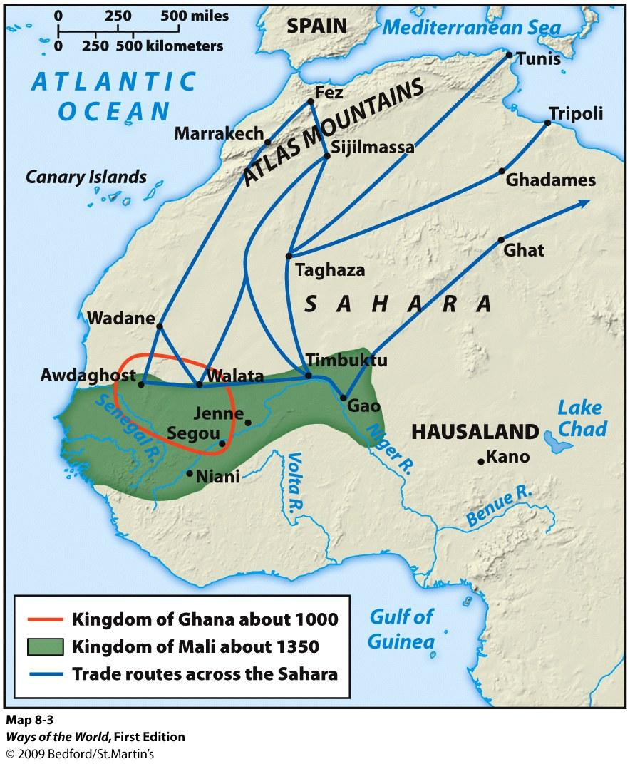
IV. Sand Roads: Exchange across the Sahara
Notes:
*

Slide 34
IV. Sand Roads: Exchange across the Sahara
A. Commercial Beginnings in West Africa
1. trans-African trade was also based on environmental variation
a. North Africa manufactured goods
b. Sahara had copper and salt deposits, dates
c. agricultural peoples further south grew crops, produced textiles, mined gold
2. earliest trade in the region was among agricultural peoples in the Sudan
a. emergence of urban clusters in the early centuries C.E.
b. most famous was Jenne-jeno (Niger Valley civilization)
Notes:
*

Slide 35
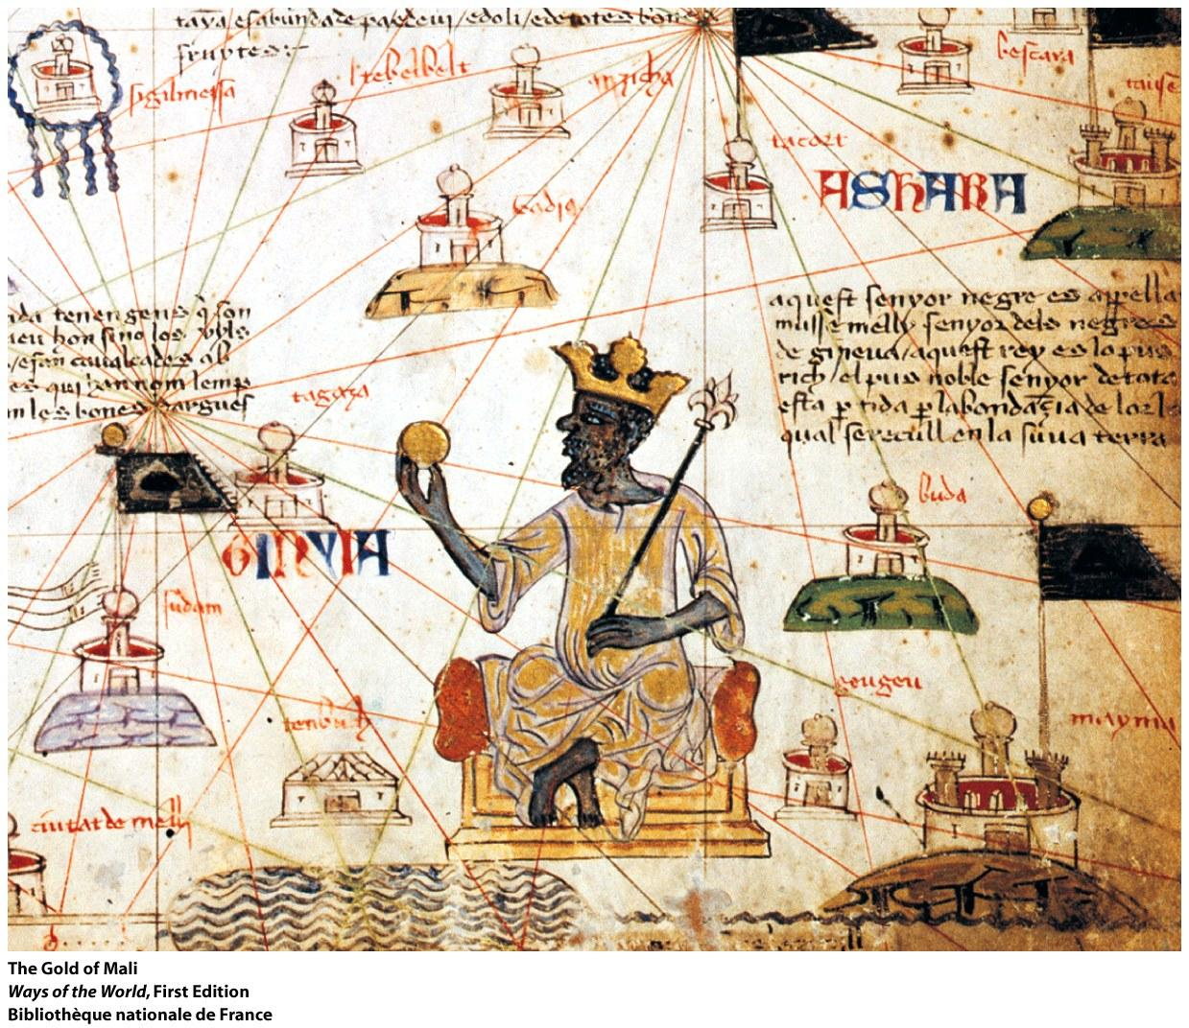

Slide 36
IV. Sand Roads: Exchange across the Sahara
B. Gold, Salt, and Slaves: Trade and Empire in West Africa
1. introduction of the camel in early centuries C.E. was a turning point
a. camels can go 10 days without water
b. made it possible to cross the Sahara
2. regular trans-Saharan commerce by 300-400 C.E.
3. merchants especially wanted gold from West Africa (along with ivory, kola nuts, slaves)
4. the Sahara became a major international trade route
a. huge caravans (as many as 5,000 camels)
b. caravans traveled the desert for over 1,000 years
Notes:
*

Slide 37
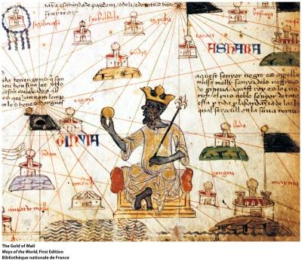
IV. Sand Roads: Exchange across the Sahara
B. Gold, Salt, and Slaves: Trade and Empire in West Africa
5. trade encouraged new and larger political structures
a. creation of a series of states in western and central Sudan between 500 and 1600 C.E., including Ghana, Mali, Songhay, Kanem, and Hausa city- states
b. all were monarchies with elaborate court life and at least some administration and military forces
c. all had a reputation for great riches
6. slavery was present in West Africa
at first, most slaves were women
with development of civilization, male slaves were used as officials, porters, craftsmen, miners, agricultural laborers
most slaves came from societies raided farther south
some 5,500 slaves a year came from across the Sahara between 1100 and 1400
7. substantial urban/commercial centers (such as Koumbi-Saleh, Jenne, Timbuktu)
a. some became manufacturing centers
b. Islam was established in towns
Notes:
*

Slide 38
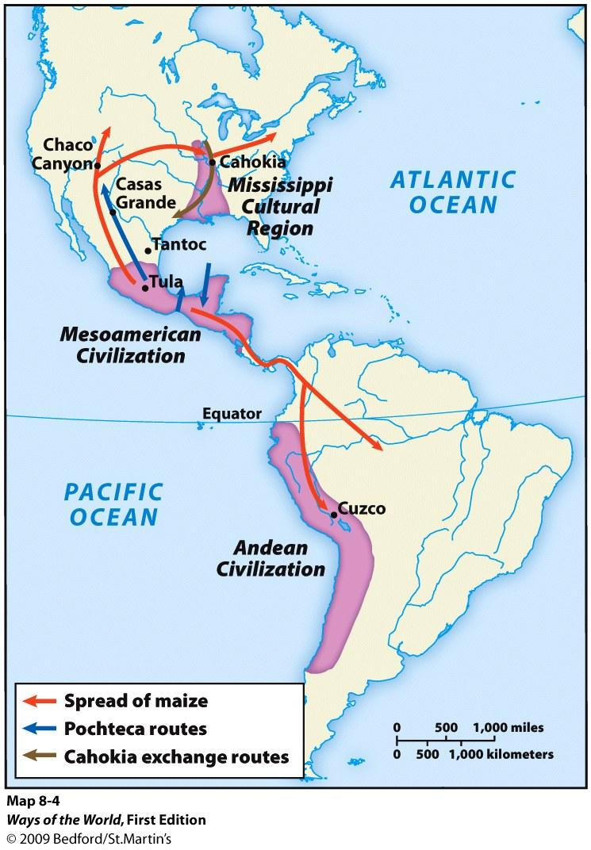
V. An American Network: Commerce and Connection in the Western Hemisphere
Notes:
*

Slide 39
V. An American Network: Commerce and Connection in the Western Hemisphere
A. No sustained interaction occurred between the Western and Eastern hemispheres before the voyages of Columbus.
B. American trade networks were not as dense as Afro-Eurasian ones.
1. important limitations:
a. lack of domesticated large mammals, wheeled vehicles, large oceangoing ships
b. geographical or environmental obstacles, including north/south orientation
2. local and regional commerce flourished, but not long-distance trade
3. cultural traditions did not spread as widely as in Eastern Hemisphere
Notes:
*

Slide 40
V. An American Network: Commerce and Connection in the Western Hemisphere
C. A "loosely interactive web" existed from the Great Lakes to the Andes.
cultural elements spread gradually
evidence of at least indirect contact
Cahokia was at center of a widespread trading network
Amazon and Orinoco river exchange networks
Caribbean peoples conducted interisland trade
Chincha people traded along Pacific coast of South America
Notes:
*

Slide 41
V. An American Network: Commerce and Connection in the Western Hemisphere
D.A major trade network operated in Mesoamerica.
Chaco canyon culture also interacted with Mesoamerica
Maya and Teotihuacan traded by land
Maya traded by sea on both coasts (with dugout canoes)
Aztecs of fifteenth century had professional merchants (pochteca)
Notes:
*

Slide 42
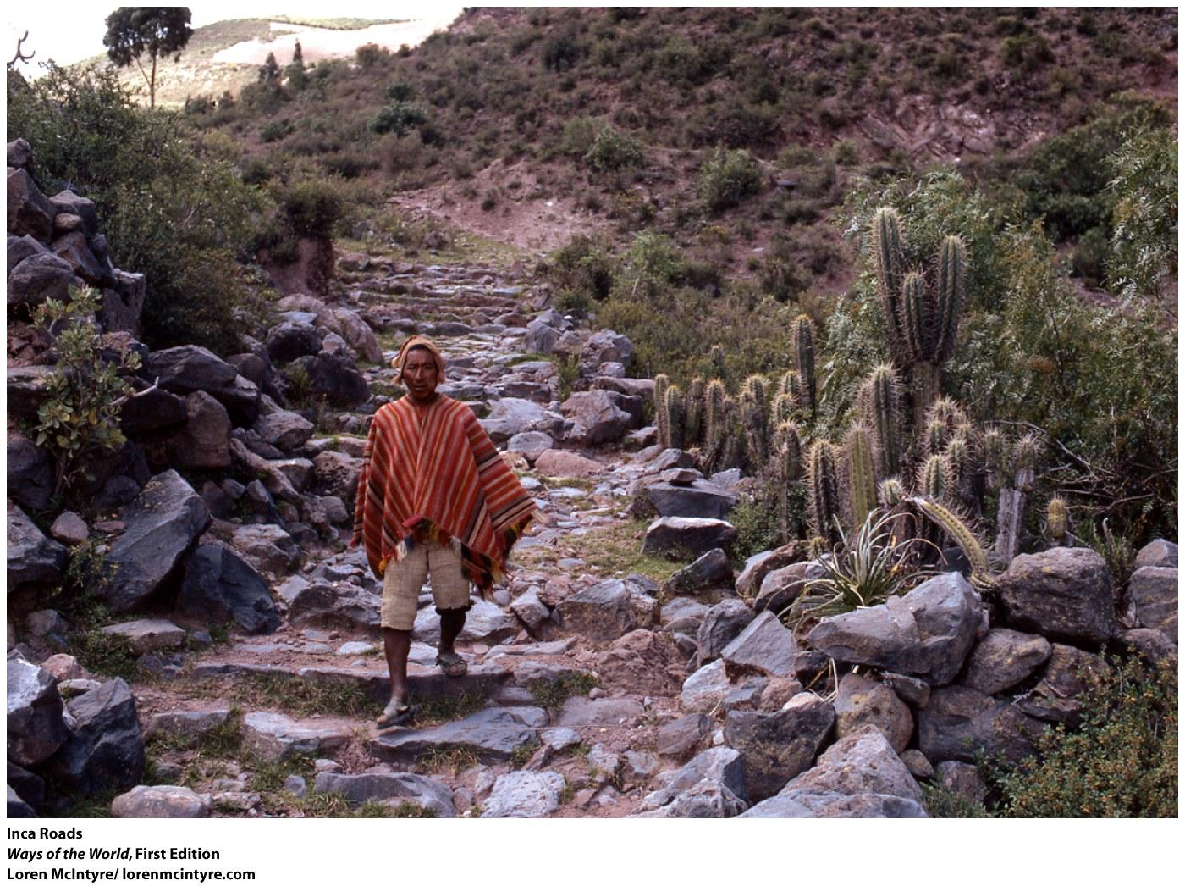
V. An American Network: Commerce and Connection in the Western Hemisphere
E. Major trade network in the Andes was largely state run.
Inca distributed supplies from great state storehouses
20,000 miles of road
some local exchange at fairs and along borders of the empire
Notes:
*

Slide 43
VI. Reflections: Economic Globalization— Ancient and Modern
A. The interconnections of the modern era have their roots in much earlier patterns.
B. But pre-modern networks had important differences:
most people still produced for their own consumption
a much smaller range of goods was exchanged
far fewer wageworkers
trade was in luxury goods
circuits of commerce were more limited
had no single center; units were much more equivalent

Slide 44
VI. Reflections: Economic Globalization— Ancient and Modern
C. The world of third-wave civilizations was more balanced and multi-centered than that of the modern era.
relationships among major civilizations were much more equal
perhaps the twenty-first century is returning to that pattern

Slide 45
WHAT'S THE SIGNIFICANCE?
American web: A term used to describe the network of trade that linked parts of the pre-Columbian Americas; although less intense and complete than the Afro-Eurasian trade networks, this web nonetheless provided a means of exchange for luxury goods and ideas over large areas.
Angkor Wat: The largest religious structure in the premodern world, construction began on this temple located in modem Cambodia in the early 1100s c.E. It was built to express a Hindu understanding of the cosmos, centered on a mythical Mt Mem, the home of the gods in Hindu tradition.
Black Death: The name given to the massive epidemic that swept Eurasia in the fourteenth century c.E.; it may have been bubonic plague, anthrax, or a collection of epidemic diseases.

Slide 46
WHAT'S THE SIGNIFICANCE?
Borobudur: The largest Buddhist monument ever built, Borobudur is a mountainous ten-level monument with an elaborate carving program, probably built in the ninth century C.E. by the Sailendras mlers of central Java; it is an outstanding example of cultural exchange and syncretism, (pron. BORE-ahboo-DOOR)
Ghana, Mali, Songhay: A series of important states that developed in western and central Sudan in the period 500-1600 c.E. in response to the economic opportunities of trans-Saharan trade (especially control of gold production), {pron. GAH-nah, MAHIee, song-GAH-ee)
Great Zimbabwe: A powerful state in the African interior that apparently emerged from the growing trade in gold to the East African coast; flourished between 1250 and 1350 c.E.

Slide 47
WHAT'S THE SIGNIFICANCE?
Indian Ocean trading network: The world's largest sea-based system of communication and exchange before 1500 C.E., Indian Ocean commerce stretched from southern China to eastern Africa and included not only the exchange of luxury and bulk goods but also the exchange of ideas and crops.
Thorfinn Karlsfeni: A well-born, wealthy merchant and seaman of Norwegian Viking background, Karlsfeni led an unsuccessful expedition to establish a colony on the coast of what is now Newfoundland, Canada, in the early eleventh century C.E.
pochteca: Professional merchants among the Aztecs.
Sand Roads: A term used to describe the routes of the trans-Sahara trade in Africa.

Slide 48
WHAT'S THE SIGNIFICANCE?
Silk Roads: Land-based trade routes that linked Eurasia.
Srivijaya: A Malay kingdom that dominated the Straits of Malacca between 670 and 1025 C.E.; noted for its creation of a native/Indian hybrid culture, (pron. sree-vih-JUH-yah)
Swahili civilization: An East African civilization that emerged in the eighth century C.E. from a blending of Bantu, Islamic, and other Indian Ocean trade elements, (pron. swah-HEE-lee)
trans-Saharan slave trade: A fairly small-scale trade that developed in the twelfth century C.E., exporting West African slaves captured in raids across the Sahara for sale mostly as household servants.

Slide 49
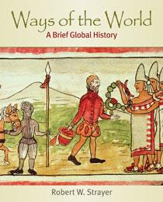
iClicker
Questions
Part III: An Age of Accelerating Connections, 500–1500 Chapter 8: Commerce and Culture, 500–1500

Slide 50
Comparison: Why did the Western Hemisphere produce a less extensive long-distance trading system than the Eastern Hemisphere?
a. Fewer desirable goods or raw materials were available to trade for in the Americas.
b. Particularly violent warfare in the Americas as compared to Eurasia suppressed trade.
c. The lack of large domesticated animals and oceangoing vessels made long-distance trade more difficult.
d. Native Americans were unable to use the river systems of the Americas for trade.

Slide 51
Connection: Even though long-distance trade predates the period between 500 c.e. and 1500 c.e., it grew in importance during this period because
a. as the volume of trade increased, it encouraged peoples in many regions of Eurasia to specialize in producing particular products for sale rather than being self-sufficient.
b. it became standard practice for merchants to regularly travel the whole length of trade routes across Eurasia bringing greater direct contact between distant civilizations.
c. India was able to dominate both the Silk Roads and the Sea Roads from east to west, bringing peace and order to the system.
d. for the first time empires sought to foster trade.

Slide 52
Change: Which of the following was NOT an outcome of the growth of Eurasian long-distance trade between 500 c.e. and 1500 c.e.?
a. Increased spread of religious ideas
b. The decline of empires as an important political structure
c. Greater specialization of some economies
d. Increased spread of diseases

Slide 53
Discussion Starter: In terms of the course of world history, which of the following exchanges that occurred because of long-distance trade between 500 c.e. and 1500 c.e. had the greatest impact?
a. The spread of diseases
b. The spread of technologies
c. The spread of religions
d. The trade of goods

Slide 54
Discussion Starter: In light of the increased long-distance contact in the Eastern Hemisphere by 1500 c.e., do you think that it is best
a. to focus primarily on individual cultural zones as they remained remarkably distinct despite the increased contact?
b. to focus primarily on individual cultural zones, but with an awareness that interaction was taking place?
c. to think of the hemisphere primarily as a single interacting zone, but to focus occasionally upon individual regions to better understand how developments differed on the ground?
d. to focus on the hemisphere as a single interacting zone?

Slide 55
Discussion Starter: Which do you think was more significant to world history, the Silk Roads or the Sea Roads?
a. The Silk Roads were more significant to world history.
b. The Sea Roads were more significant to world history.

Slide 56
Answer Key for Chapter 8
Answer is C
Answer is A
Answer is B

Slide 57
Big Picture Questions
1. What motivated and sustained the long­distance commerce of the Silk Roads, Sea Roads, and Sand Roads?
The desire of elites for hard-to-find luxury items from distant parts of the Eurasian network, as well as the accumulation of wealth, especially among merchants who participated in the trade, motivated long-distance commerce.
Sustaining the commerce were the support of empires and smaller states that benefited directly from the trade; the spread of religious traditions, including Islam and Buddhism, which, through shared beliefs, tied merchants and sometimes whole societies together over wide regions; and the development of technologies like larger ships and the magnetic compass.

Slide 58
Big Picture Questions
2. Why did the peoples of the Eastern Hemisphere develop long-distance trade more extensively than did those of the Western Hemisphere?
The Western Hemisphere did not develop the extensive long-distance trade as did the East for several reasons, including the absence of large domesticated mammals in the Americas and the absence of large oceanic vessels.
The geographical realities of the Americas, especially the narrow bottleneck of Panama, which was largely covered by dense rain forests, made long-distance trade more difficult.
Finally, the north/south orientation of the Americas, which required agricultural practices to move through, and adapt to, quite distinct climatic and vegetation zones, hindered east/west expansion and trading.

Slide 59
Big Picture Questions
3."Cultural change derived often from commercial exchange in the third-wave era." What evidence from this chapter supports this observation?
Commercial exchange frequently provided the incentives and resources for the creation of larger, more powerful states.
It provided sustained contact through which cultural influences were also exchanged, as was the case with the spread of Buddhism and Islam.
It facilitated the spread of epidemic diseases beyond local regions, with sometimes devastating effects.
It resulted in the spread of plants and animals along with technological innovations.
It altered consumption patterns.
It encouraged specialization and diminished the economic self-sufficiency of local societies.
Sometimes it was a means of social mobility, with traders often becoming a distinct social group.

Slide 60
Big Picture Questions
4. In what ways was Afro-Eurasia a single interacting zone, and in what respects was it a vast region of separate cultures and civilizations?
Afro-Eurasia was an interacting zone in that it was a network of exchange that stretched all across the Afro-Eurasian world; and it altered consumption and encouraged peoples across the zone to specialize in producing particular products for sale rather than being self-sufficient. The spread of ideas and diseases across large parts of the interacting zone provides evidence of extensive and sustained contact across long distances.
However, it was also a vast region of separate cultures: none of the participants knew the full extent of the zone, for it was largely a "relay trade" in which goods were passed down the line, changing hands many times before reaching their final destination; and numerous distinct cultural traditions existed side by side across the zone throughout the period.

Slide 61
Big Picture Questions
5. Looking Back: Compared to the cross- cultural interactions of earlier times, what was different about those of the third-wave era?
The scale of interaction was far greater than before.
More regions became commercialized to a greater extent than in the past.
The Sand Roads became a major route of exchange.
Islam and Buddhism spread across cultural zones during this period.
States emerged in regions where no states had existed in the past.

Slide 62
Seeking the Main Point Question
Q. In what ways did long-distance commerce act as a motor of change in premodern world history?
Commercial exchange frequently provided the incentives and resources for the creation of larger, more powerful states.
It provided sustained contact through which cultural influences were also exchanged, as was the case with the spread of Buddhism and Islam.
It facilitated the spread of epidemic diseases beyond local regions, with sometimes devastating effects.
It resulted in the spread of plants and animals along with technological innovations.
It altered consumption patterns.
It encouraged specialization and diminished the economic self-sufficiency of local societies.
Sometimes it was a means of social mobility, with traders often becoming a distinct social group.

Slide 63
Margin Review Questions
Q. What lay behind the emergence of Silk Road commerce, and what kept it going for so many centuries?
One important reason was the exchange of products of the forest and of the semi-arid northern grasslands of inner Eurasia, which were controlled by pastoral peoples, for the agricultural products and manufactured goods of the warmer, well-watered lands of outer Eurasia, including the Mediterranean, the Middle East, India, and China.
Also important were the construction of second-wave civilizations and their imperial states during the last five centuries B.C.E.; second-wave civilizations invaded the territory of pastoral peoples, securing sections of the Silk Roads and providing security for merchants and travelers.
The Silk Road had the continued support of later states, including the Byzantine, Abbasid, and Mongol empires, which also benefited from the trade.
There was a continuing demand for hard-to-find luxury goods among elites across Eurasia.

Slide 64
Margin Review Questions
Q. What made silk such a highly desired commodity across Eurasia?
Silk was used as currency and as a means of accumulating wealth in Central Asia.
It became a symbol of high status in China and the Byzantine Empire.
It became associated with the sacred in the expanding world religions of Buddhism and Christianity.

Slide 65
Margin Review Questions
Q. What were the major economic, social, and cultural consequences of Silk Road commerce?
• In some regions, long-distance trade profoundly affected the lives of peasant farmers. For instance, peasants in the Yangzi River delta of southern China sometimes gave up the cultivation of food crops, choosing to focus instead on producing silk, paper, porcelain, lacquer-ware, or iron tools, much of which was destined for the markets of the Silk Roads.
• Favorably placed individuals could benefit enormously from long-distance trade; some merchants accumulated considerable fortunes.

Slide 66
Margin Review Questions
Q. What accounted for the spread of Buddhism along the Silk Roads?
Buddhism appealed to Indian merchants, who preferred its universal message to that of a Brahmin-dominated Hinduism that privileged the higher castes.
Many inhabitants of the sophisticated and prosperous oasis cities of Central Asia that engaged in long-distance trade found in Buddhism a link to the larger, wealthy, and prestigious civilization of India. This resulted in many voluntary conversions.
Well-to-do Buddhist merchants built monasteries and supported monks to earn religious merit. These monasteries in turn provided convenient and culturally familiar places of rest and resupply for merchants making the trek across Central Asia.
Buddhism progressed only slowly among pastoral peoples of Central Asia. It had its greatest success when pastoralists engaged in long-distance trade or came to rule settled peoples.
In China, Buddhism remained for many centuries a religion of foreign merchants or foreign rulers. Only slowly did it become popular among the Chinese themselves.
As it spread, Buddhism changed, and some of these changes may have made it more appealing to local populations. In particular, the Mahayana form of Buddhism flourished, its emphasis on compassion and the possibility of earning merit making it more appealing than the more austere psychological teachings of the original Buddha.
As it spread, Buddhism picked up elements of other cultures, including Greek influences, and the gods of many peoples along the Silk Roads were incorporated into Buddhist practice as bodhisattvas.

Slide 67
Margin Review Questions
Q. What was the impact of disease along the Silk Roads?
Contact led to peoples being exposed to unfamiliar diseases to which they had little immunity or effective methods of coping.
The spread of some particularly virulent epidemic diseases could lead to deaths on a large scale.
The worst example of this occurred in the fourteenth century, when the Black Death, identified variously with bubonic plague, anthrax, or a package of epidemic diseases, swept away nearly one-third of the population in Europe, China, and the Middle East.
• In the long run, the exchange of diseases gave Europeans a certain advantage when, after 1500, they confronted the peoples of the Western Hemisphere, who had little natural protection from the diseases of the Eastern Hemisphere.

Slide 68
Margin Review Questions
Q. What lay behind the flourishing of Indian Ocean commerce in the postclassical millennium?
One important factor was the economic and political revival of China, especially during the Tang and Song dynasties (618-1279).
China both supplied products for and consumed the products of the Indian Ocean trading network.
China also provided technological innovations, including larger ships and the magnetic compass, which facilitated trade.
Another important factor was the sudden rise of Islam in the seventh century c.E. and its subsequent spread across much of the Afro-Eurasian world.
Islam was friendly to commercial life. The creation of an Arab Empire, stretching from the Atlantic Ocean through the Mediterranean basin and all the way to India, brought together in a single political system an immense range of economies and cultural traditions and provided a vast arena for trade.
Middle Eastern gold and silver purchased pepper, textiles, and gemstones in India.
Merchants from the Arab Empire established communities from East Africa to the China coast.
Opportunities for trade led to the production of sugar and dates in Mesopotamia and stimulated a slave trade from East Africa to provide labor for the growing and refining of these products.
Widespread conversion to Islam among traders in the Indian Ocean underpinned an international maritime culture and also helped to facilitate commercial transactions.

Slide 69
Margin Review Questions
Q. In what ways did Indian influence register in Southeast Asia?
Indian alphabets were used to write a number of Southeast Asian languages.
Indian artistic forms provided models for sculpture and architecture.
The Indian epic Ramayana became widely popular.
Southeast Asian rulers and elites found attractive the Indian belief that leaders were god-kings.
Indian ideas about karma conveyed legitimacy to the rich and powerful based on their moral behavior in earlier lives.
Srivijaya monarchs employed Indians as advisers, clerks, and officials.
The Buddist and Hindu faiths both attracted significant followings in Southeast Asia.

Slide 70
Margin Review Questions
Q. What was the role of Swahili civilization in the world of Indian Ocean commerce?
Economically, Swahili cities provided commercial centers that accumulated goods from the interior of sub-Saharan Africa and exchanged them for the products of the Indian Ocean trading network.
Culturally, Swahili civilization also participated in the larger Indian Ocean world. Most important, Swahili civilization rapidly and voluntarily became Islamic. Moreover, Arab, Indian, and perhaps Persian merchants visited and sometimes permanently settled in Swahili cities.
Swahili rulers often claimed Arab or Persian origins to bolster their authority.
In terms of material culture, Swahili elite dined off Chinese porcelain and dressed in Indian cottons.
The Swahili language was grammatically a Bantu African tongue, but it was written in Arabic script and contained a number of Arabic loan words.

Slide 71
Margin Review Questions
Q. Summing Up So Far: To what extent did the Silk Roads and the Sea Roads operate in a similar fashion? How did they differ?
In terms of similarities:
the role of commerce in the creation and maintenance of the networks
the spread of ideas and technologies along the routes
the commercialization of communities that participate in the routes
the role of states along the two routes
In terms of differences:
the lack of pastoralist participation on the Sea Roads
the use of caravans versus vessels
the commodity goods traded on the Sea Routes but not the Sand Roads
• the direct participation of East Africa and Southeast Asia in the Sea Roads but not the Silk Roads.

Slide 72
Margin Review Questions
Q. What changes did trans-Saharan trade bring to West Africa?
It provided both incentives and resources for the construction of new and larger political structures, including the city-states of the Hausa people and the empires of Ghana, Mali, Songhay, and Kanem.
These Sudanic states established substantial urban and commercial centers where traders congregated and goods were exchanged. Some also became manufacturing centers, creating finely wrought beads, iron tools, or cotton textiles for trade.
Islam accompanied trade and became an important element in the urban culture of West Africa.

Slide 73
Margin Review Questions
Q. In what ways did networks of interaction in the Western Hemisphere differ from those in the Eastern Hemisphere?
Direct connections among the civilizations and cultures of the Americas were less densely woven than in the Afro-Eurasian region. There was no equivalent in the Western Hemisphere to the long­distance trade of the Silk, Sea, or Sand Roads of the Eastern Hemisphere.
The spread of agricultural products was slower and less pronounced in the Americas than in Eurasia. The north/south orientation of the Americas required agricultural practices to adapt to various and distinct climatic and vegetation zones, whereas the east/west orientation of Eurasia made crop dissemination easier and quicker there.
The Americas had no equivalent to the spread of distinct cultural traditions like Buddhism, Christianity, or Islam that ultimately helped to integrate distant peoples in the Afro-Eurasian web.
Nevertheless, the Americas did have zones of interaction, as reflected in the slow spread of cultural elements.
Commerce did play an important role in regions where contact was possible—for instance, along the river networks of North America, in the Amazon basin, and between the islands of the Caribbean. But the most active and dense networks of communication and exchange lay within, rather than between, the regions that housed the two great civilizations of the Western Hemisphere— Mesoamerica and the Andes.

Slide 74
Chapter 8 Commerce and Culture, 500–1500
Map 8.1 The Silk Roads (p. 219)
Map 8.2 The Sea Roads (p. 226)
Map 8.3 The Sand Roads (p. 234)
Map 8.4 The American Web (p. 236)
Spot Map 8.1 Southeast Asia ca. 1200 C.E. (p. 229)
Spot Map 8.2 The Swahili Coast of East Africa (p. 231)
Travels on the Silk Road (p. 216)
Dunhuang (p. 223)
Borobudur (p. 230)
The Gold of Mali (p. 235)
Inca Roads (p. 237)
Notes:
*

Slide 75
Notes:
*

Slide 76
Notes:
*

Slide 77
Notes:
*

Slide 78
Notes:
*

Slide 79
Notes:
*

Slide 80
Notes:
*

Slide 81
Notes:
*

Slide 82
Notes:
*

Slide 83
Notes:
*

Slide 84
Notes:
*

Slide 85
Notes:
*

